Slide 1
Roadmapp
Team: Sharony Braam & Daan Brocatus

Slide 2

Case
Business owner Simon
Business

Slide 3
Concept
Roadmap: a set of tutorials/educational resources in order to acquire more knowledge about a skillset.
Unique roadmap
Track your progress
Earn achievements based on completion
Export roadmap to Google Calendar

Slide 4
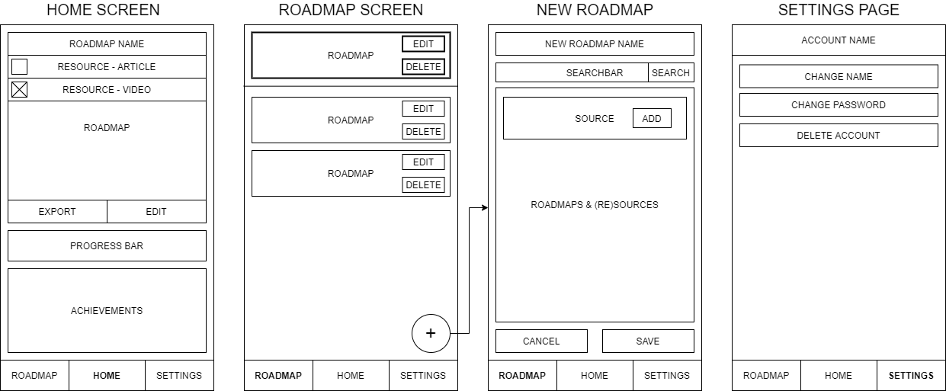
Low Fidelity Prototype

Slide 5
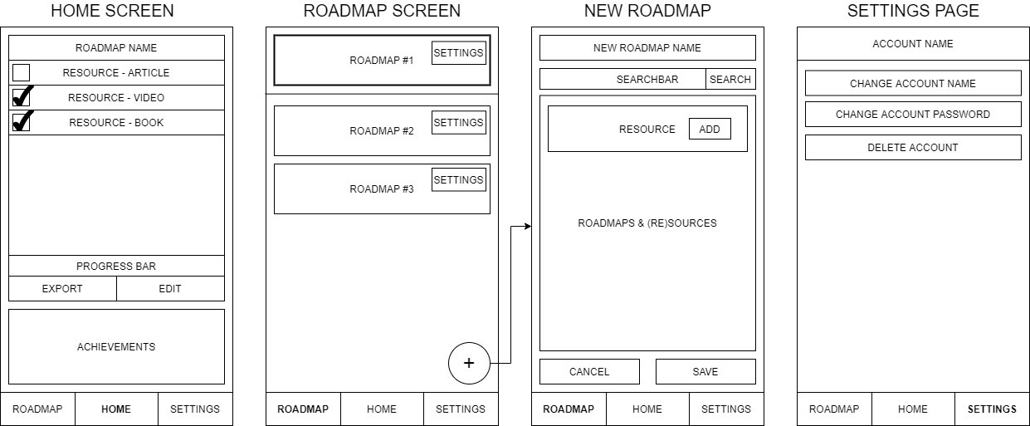
Low Fidelty Prototype V2

Slide 6
Medium Fidelity Prototype
https://www.figma.com/proto/2QMlBwpsGuuExsP5ZwAwrG/Roadmapp?node-id=0%3A3&scaling=scale-down

